Slide 1
Chapter/Topic 5
Incident Response and Investigation
CSSY4103 - Security Operations Centre (SOC)

Slide 2
Objectives
After studying this chapter, you should be able to:
  Understand the incident response lifecycle (PICERL).
  Develop a comprehensive understanding of incident handling procedures tailored to various types of cybersecurity threats.
  Gain foundational knowledge in digital forensics to support incident response efforts.

Slide 3
Incident Response
Incident response is a systematic procedure that enables organizations to identify, prioritize, restrict, and eliminate cyberattacks.
The objective of incident response is to guarantee that companies are promptly informed of important security occurrences and take immediate steps to halt the attacker, mitigate the resulting harm, and prevent more attacks or similar incidents from occurring in the future.

Slide 4
Incident Response Frameworks
Incident response (IR) frameworks provide a structured approach for dealing with cybersecurity threats and breaches.
In a SOC, these frameworks ensure that incidents are managed effectively and consistently, minimizing damage and aiding in swift recovery.
Several established frameworks offer guidance on how to detect, contain, and respond to security incidents.
  NIST Incident Response Framework (NIST 800-61)
  SANS Incident Response Process
  ISO/IEC 27035 Incident Management
Notes:
Well-Known Incident Response Frameworks in SOC
Several established incident response frameworks are utilized by SOC teams to handle and manage security incidents. These frameworks help ensure consistency, efficiency, and thoroughness in dealing with incidents. Below are some of the most prominent ones:
NIST Incident Response Framework (NIST 800-61)
Developed by the National Institute of Standards and Technology (NIST), this framework is one of the most widely adopted. It defines four key phases:
Preparation
Detection and Analysis
Containment, Eradication, and Recovery
Post-Incident Activity
Application in SOC:
SOC teams rely on the NIST framework for guidance on setting up proper detection mechanisms, developing response plans, and handling incidents. It emphasizes detailed documentation and learning from incidents, which can help SOC teams improve over time.
SANS Incident Response Process
The SANS framework outlines six steps in the incident response process:
Preparation
Identification
Containment
Eradication
Recovery
Lessons Learned
Application in SOC:
Similar to NIST, the SANS process provides detailed steps to prepare for and handle incidents. SOC analysts and responders follow this methodology to ensure all aspects of an incident are handled systematically, from initial detection to post-incident analysis.
CERT® Incident Management Capability Maturity Model (CERT-IMM)
This framework focuses on improving the maturity and capability of an organization's incident response process. It defines five levels of maturity, ranging from Initial to Optimizing, with the goal of continuous improvement.
Application in SOC:
SOCs that aim for long-term improvements in their response processes use CERT-IMM to measure and evolve their incident response maturity. This framework helps align the SOC's incident response efforts with the overall strategic goals of the organization.
MITRE ATT&CK® for Incident Response
While primarily a threat intelligence and attack framework, MITRE ATT&CK has become a valuable resource for incident response in SOCs. It helps analysts map observed attack patterns to specific adversary tactics, techniques, and procedures (TTPs).
Application in SOC:
SOCs use MITRE ATT&CK to enhance their detection capabilities and correlate incidents with known attack patterns. This framework aids in the identification and analysis phases, allowing for more precise response actions based on the observed techniques.
Cyber Kill Chain (Lockheed Martin)
This framework is designed to break down the steps attackers take during a cyberattack. The phases include:
Reconnaissance
Weaponization
Delivery
Exploitation
Installation
Command and Control (C2)
Actions on Objectives
Application in SOC:
SOC teams use the Cyber Kill Chain to trace how far an attack has progressed and to identify the most appropriate point to contain or mitigate the attack. By understanding where an adversary is within the chain, SOC teams can respond with more precision and reduce the impact of the incident.
ISO/IEC 27035 Incident Management
The ISO/IEC 27035 framework provides an international standard for information security incident management, focusing on the identification, response, and prevention of incidents.
Application in SOC:
SOCs that align with international security standards often adopt ISO/IEC 27035 to ensure that their incident management processes are standardized and meet global best practices.

Slide 5
Incident Response Frameworks
NIST 800-61
Title: Computer Security Incident Handling Guide
Publisher: National Institute of Standards and Technology (NIST)
Focus: Provides guidelines for incident handling to ensure effective management of cybersecurity incidents in organizations.
Purpose: Aims to help organizations prepare for, detect, analyze, and respond to incidents, ensuring lessons learned are incorporated into future incident handling.

Slide 6
Incident Response Frameworks
SANS Incident Response
Title: SANS Institute Incident Response Process
Publisher: SANS Institute
Focus: Offers a comprehensive process for responding to cybersecurity incidents based on practical experiences and training.
Purpose: Provides a clear, actionable framework for organizations to follow when handling incidents, emphasizing the importance of preparation and learning from past incidents.

Slide 7
Incident Response Frameworks
ISO/IEC 27035
Title: Information Security Incident Management
Publisher: International Organization for Standardization (ISO) and International Electrotechnical Commission (IEC)
Focus: A standard for managing information security incidents, applicable to any organization, regardless of size or type.
Purpose: Establishes guidelines for incident management processes to help organizations prepare for, detect, respond to, and recover from incidents effectively.

Slide 8
Strengths and Limitations
Framework | Strengths | Limitations
NIST 800-61 | Comprehensive and systematic approach; Well-recognized in both public and private sectors | May be overly complex for smaller organizations; Requires adaptation to fit specific environments
SANS Incident Response | Practical and actionable steps; Focus on training and real-world application | Less formal structure may lead to variability in implementation; Not as widely recognized as an official standard
ISO/IEC 27035 | Internationally recognized standard; Provides a formalized approach to incident management | Implementation may be complex and resource-intensive; Requires commitment from all levels of the organization

Slide 9
PICERL framework

Slide 10
SANS Incident Response Framework
The PICERL framework, which stands for Preparation, Identification, Containment, Eradication, Recovery, and Lessons Learned, was proposed by the SANS Institute.
The framework is designed to provide a structured approach to incident response, emphasizing the need for thorough preparation and post-incident analysis

Slide 11
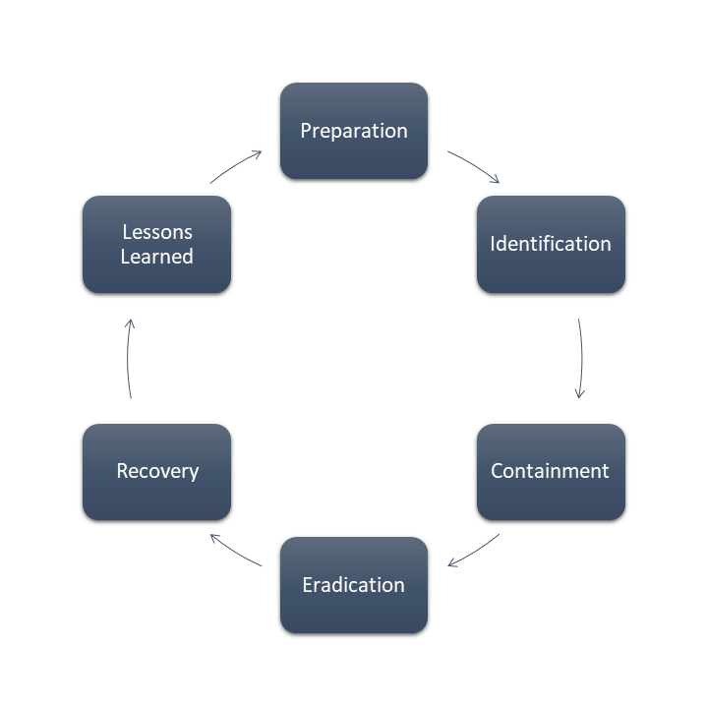
Incident response lifecycle
PICERL stands for Preparation, Identification, Containment, Eradication, Recovery, and Lessons Learned.
It is a framework for handling cybersecurity incidents, guiding teams through the stages of identifying and responding to threats.
Each phase of the PICERL process serves a critical function in addressing and recovering from cybersecurity incidents.

Slide 12
PICERL | Preparation
Identifying potential vulnerabilities in an organization's security posture and developing a plan to address them.
This phase involves getting ready before any incident occurs. It focuses on establishing policies, procedures, and tools to handle incidents efficiently.
Key activities include:
  Developing and testing an incident response plan.
  Setting up security measures such as firewalls, IDS, and others.
  Training staff to recognize and respond to security threats.
  Defining roles and responsibilities for the incident response team.
Goal: Build a solid foundation for identifying and responding to incidents quickly and effectively.

Slide 13
PICERL | Identification
Identifying the nature of the security incident and determining its potential impact on the organization.
In this phase, the organization focuses on detecting and verifying potential security incidents. This includes monitoring systems, reviewing alerts, and analyzing suspicious activity to determine whether a real threat is present.
Common tasks include:
  Reviewing logs from security tools (e.g., IDS/IPS, SIEM).
  Monitoring network traffic and user activity.
  Analyzing anomalies or suspicious events.
  Identifying indicators of compromise (IoCs).
Goal: Detect security incidents early to limit potential damage.

Slide 14
PICERL | Containment
Execution of steps to prevent the security incident from spreading further or causing more harm.
Once an incident is confirmed, the next step is to contain the threat to prevent further harm.
Containment strategies are divided into:
  Short-term containment: Immediate actions to prevent further damage, such as isolating compromised systems.
  Long-term containment: Implementing measures that will remain in place while planning for complete eradication.
Goal: Stop the spread of the attack while keeping critical systems operational.

Slide 15
PICERL | Eradication
Executing steps to remove the root cause of the security incident and prevent it from occurring again in the future.
In this phase, the focus shifts to eliminating the root cause of the incident. May involves removing malware, closing exploited vulnerabilities, or disabling compromised accounts.
Key tasks include:
  Cleaning infected systems (e.g., removing malware).Patching vulnerabilities or flaws exploited by attackers.
  Strengthening defenses to prevent re-entry.
  Verifying that no remaining threats (backdoors, hidden malware) exist.
Goal: Fully remove the attacker’s presence and prevent re-infection.

Slide 16
PICERL | Recovery
Performing steps to restore affected systems or data and ensure that the organization can continue to function normally.
After eradicating the threat, the organization works to restore normal operations while ensuring that systems are functioning correctly.
Key tasks include:
  Restoring data from backups.
  Bringing systems back online safely.
  Monitoring restored systems for any signs of abnormal activity.
  Confirming that security issues have been fully resolved.
Goal: Safely return systems to normal operations without reintroducing the attack.

Slide 17
PICERL | Lessons Learned
Documenting what was learned from the security incident and how it can be applied to prevent similar incidents in the future.
Once the incident has been fully resolved, it’s important to review the entire process and identify areas for improvement.
Key tasks include:
  Conducting a post-incident analysis to assess what went wrong and what worked well.
  Updating the incident response plan based on the experience.
  Providing additional training or resources to the team if necessary.
  Documenting the entire incident and response process.
Goal: Improve the organization’s incident response plan and strengthen security for future incidents.

Slide 18
Student Self Study!
Download The Incident Handlers Handbook from here (https://sansorg.egnyte.com/dl/6Btqoa63at)
Familiarize your self with the Incident Handlers Checklist (pp 11)
Understand how anomalies are identified in Window OS (Section 9) and Linux OS (Section 10) and what indicators point can be collected.

Slide 19
Class Activity
Consider the following scenario:
  A mid-sized financial services company experienced a cybersecurity incident when a phishing email successfully led to a malware infection on several employee workstations.
  The Security Operations Center (SOC) is tasked with managing this incident by applying the SANS PICERL framework to ensure a structured and effective response.
Discuss and answer the following questions [next slide]

Slide 20
Phase-wise questions (1/2)
Preparation:
  1. Describe the steps that the SOC should take in advance to prepare for potential incidents.
Identification:
  2. What tools and methods would be used to identify the malware infection?
  3. Outline the specific indicators of compromise (IoCs) the SOC analysts should look for in this scenario.
Containment:
  4. Identify both short-term and long-term containment measures the SOC could implement once the incident is confirmed.
  5. Discuss the importance of isolating affected systems and what actions should be taken to prevent further spread of the malware.

Slide 21
Phase-wise questions (2/2)
Eradication:
  6. Explain the actions the SOC should take to remove the malware from infected systems. Include steps for addressing vulnerabilities that allowed the incident to occur.
  7. Discuss the role of forensic analysis in this phase and what information should be gathered.
Recovery:
  8. Outline the steps the SOC should follow to restore normal operations after the incident. How can the SOC ensure that the systems are secure before reconnecting them to the network?
Lessons Learned:
  9. Discuss the importance of conducting a post-incident review.

Slide 22
1. Describe the steps that the SOC should take in advance to prepare for potential incidents.
Before the incident, the SOC took the following practical actions:
  Security Policy Development:
    Established comprehensive policies regarding acceptable use, incident reporting, and security awareness.
  Training and Awareness Programs:
    Conducted regular training sessions for employees to recognize phishing attempts and other social engineering tactics. These sessions included simulated phishing emails to test employee awareness.
  Tool Deployment:
    Implemented security tools, including:
      Anti-virus and anti-malware solutions across all workstations.
      Firewalls and intrusion detection systems (IDS) to monitor network traffic.
      Security information and event management (SIEM) systems for real-time alerting and monitoring.
  Incident Response Plan:
    Developed a documented incident response plan outlining roles, responsibilities, and procedures, ensuring that all team members knew their tasks in the event of an incident.

Slide 23
2. What tools and methods would be used to identify the malware infection?
Upon noticing unusual network activity, the SOC analysts performed the following steps to identify the incident:
  Alert Monitoring: Used the SIEM system to monitor for alerts indicating unusual behavior, such as increased outbound traffic from specific workstations.
  Log Analysis: Analyzed email logs and security event logs to trace the origin of the attack. They identified the phishing email and tracked the malware's entry point.
  User Reports: Collected reports from employees who noticed suspicious activity on their systems, confirming the existence of the malware

Slide 24
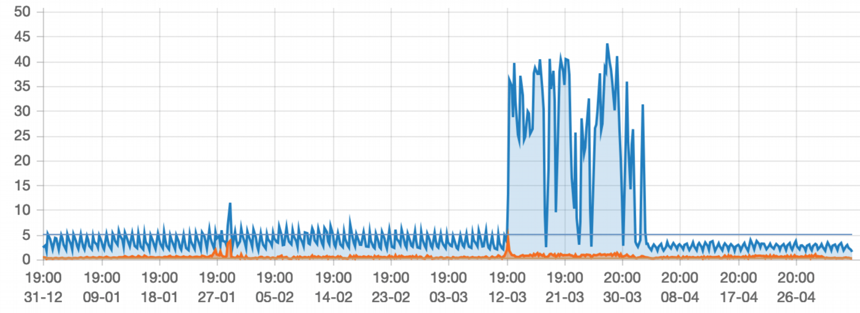
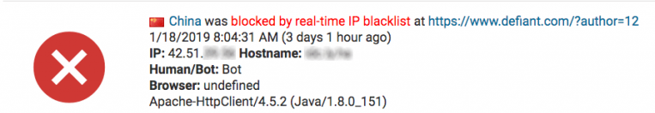
3. Outline the specific indicators of compromise (IoCs) the SOC analysts should look for in this scenario.
Indicators of Compromise (IoCs):
  Unusual outbound network traffic patterns.
  Presence of known malicious IP addresses or domains in logs.
  Reports from employees about suspicious emails or system behaviors.
  Unexpected changes to files or processes on affected workstations.
Example of known malicious IP addresses
  Example of unusual outbound network traffic patterns

Slide 25

4. Identify both short-term and long-term containment measures the SOC could implement once the incident is confirmed.
Short-Term Containment Measures:
  Immediately isolate affected workstations from the network by disabling their network connections to prevent the spread of malware.
  Temporarily suspend user accounts associated with infected systems to limit further access.
Long-Term Containment Measures:
  Develop temporary patches for affected systems to restrict access while a more permanent solution is being implemented.
  Review and adjust firewall rules and access controls to further limit exposure.
Source of image: dreamstime.com

Slide 26
5. Discuss the importance of isolating affected systems and what actions should be taken to prevent further spread of the malware.
Isolating affected systems during a cybersecurity incident is crucial for several reasons:
  Preventing Further Spread:
    The primary goal of isolating infected systems is to halt the malware's ability to propagate within the network. Once a system is compromised, malware can often spread to other connected devices or systems. Isolating the affected machines ensures that the threat does not escalate or affect additional assets​.
  Minimizing Damage:
    By containing the affected systems, organizations can minimize the potential damage that malware may cause. This includes preventing data loss, theft, or corruption.
    Isolated systems can be assessed and remediated without risking critical business operations​.
  Facilitating Forensic Investigation:
    Isolating affected systems allows incident response teams to conduct a forensic investigation without interference. This is essential for identifying the root cause of the incident, understanding how the malware entered the environment, and developing strategies to prevent future occurrences.
  Maintaining Business Continuity:
    By isolating infected systems, organizations can continue to operate unaffected parts of their infrastructure. This containment strategy helps maintain essential services while the incident is being managed​.

Slide 27

6. Explain the actions the SOC should take to remove the malware from infected systems.
When a Security Operations Center (SOC) identifies a malware infection on systems, several critical actions should be taken to effectively eradicate the threat. These actions can be categorized into several key phases:
Phase 1: Initial Assessment and Containment:
  Assess the Extent of Infection: The SOC should quickly determine the scope of the malware infection, identifying which systems are affected and the type of malware involved. This assessment helps prioritize remediation efforts .
  Contain Affected Systems: Before proceeding with removal, it is essential to isolate the infected systems from the network to prevent further spread of the malware, as previously discussed .
Source of image: pinclipart.com

Slide 28
6. Explain the actions the SOC should take to remove the malware from infected systems.
Phase 2: Malware Identification:
  Use Threat Intelligence: Utilize threat intelligence resources to gather information on the specific malware variant involved in the incident. This can include identifying known signatures and behavior patterns associated with the malware .
  Run Scans with Updated Security Tools: Conduct comprehensive scans using reputable anti-virus and anti-malware software. It is critical to ensure that these tools are updated to recognize the latest threats.
Phase 3: Malware Removal:
  Quarantine and Delete: Once the malware is identified, the SOC should quarantine the affected files and applications. Most modern anti-malware tools provide options to isolate or delete detected threats safely .
  Manual Removal (if necessary): In some cases, particularly with sophisticated or rootkit malware, automated tools may not be sufficient. The SOC may need to manually remove malware components, including registry entries or malicious files, while ensuring that system integrity is maintained.

Slide 29
7. Discuss the role of forensic analysis in this phase and what information should be gathered.
Forensic analysis helps identify the root cause of the incident, providing insights into how the attack occurred and guiding future prevention strategies.
Forensic analysis allows incident responders to thoroughly examine the malware, identifying its various components and methods of operation. Understanding the complete structure and functionality of the malware is crucial for effectively removing it without leaving remnants that could lead to a re-infection​(
Many malware strains employ techniques to persist across reboots or re-installations. Forensic analysis can uncover these persistence mechanisms—such as modified registry entries, scheduled tasks, or startup programs—ensuring that all methods of reinfection are identified and eliminated.
The evidence collected during forensic analysis may be required for legal or compliance reasons. Proper documentation of findings helps organizations meet regulatory obligations and can support legal action against perpetrators.

Slide 30
8. Outline the steps the SOC should follow to restore normal operations after the incident.
Steps for System Restoration:
  Clean and rebuild affected workstations using secure images to ensure no remnants of the malware remain.
  Apply security patches and updates to all systems before reconnecting them to the network.
Ensuring Security Before Reconnection:
  Conduct thorough testing to verify that systems are functioning correctly and securely.
  Monitor affected systems closely after recovery to detect any signs of residual malware or potential threats.

Slide 31
9. Discuss the importance of conducting a post-incident review.
Learning from Experience:
  The "Lessons Learned" phase helps the SOC capture insights on response effectiveness and gaps, improving defenses against future attacks.
Identifying Weaknesses:
  The review identifies system and process vulnerabilities, guiding the prioritization of patches, updates, and security investments.
Improving Incident Response Procedures:
  It evaluates the effectiveness of the response plan, team coordination, and decision-making during the incident.
Documentation for Compliance:
  The review ensures proper documentation, meeting compliance requirements and aiding audits or legal processes.
Strengthening Team Competency:
  It assesses team performance, identifying areas for improvement and targeting future training efforts.

Slide 32
Incident handling procedures

Slide 33
Incident handling procedures for different types of threats
Security incident handling procedures vary depending on the type of threat faced. Here are some general guidelines for handling different types of security threats:
Malware Infections:
  Isolate the infected system from the network to prevent further spread.
  Identify the type and source of the malware.
  Use antivirus software to scan and remove the malware if possible.
  Update antivirus signatures and apply patches to vulnerable systems.
  Restore affected systems from clean backups if necessary.
  Conduct a thorough investigation to determine the extent of the infection and any data breaches.
2. Unauthorized Access (e.g., hacking, insider threats):
  Immediately revoke access privileges for the compromised account or system.
  Change passwords and access credentials for affected accounts.
  Preserve evidence by logging relevant information and activities.
  Investigate the source of the unauthorized access and assess the damage.
  Implement additional security measures such as two-factor authentication.
  Patch vulnerabilities and update security configurations to prevent future breaches.

Slide 34
Incident handling procedures for different types of threats
3. Denial-of-Service (DoS) Attacks:
  Mitigate the impact of the attack by filtering or blocking malicious traffic.
  Monitor network traffic and system performance to identify the source of the attack.
  Notify internet service providers (ISPs) or relevant authorities if necessary.
  Implement DoS protection mechanisms such as rate limiting and traffic shaping.
  Consider deploying redundancy and failover mechanisms to maintain service availability.
4. Data Breaches:
  Contain the breach and limit further exposure of sensitive data.
  Notify affected individuals and regulatory authorities as required by law.
  Preserve evidence for forensic analysis and legal purposes.
  Conduct a comprehensive investigation to determine the cause and scope of the breach.
  Implement remediation measures such as encryption, access controls, and monitoring.
  Review and update security policies and procedures to prevent similar incidents in the future.

Slide 35
Incident handling procedures for different types of threats
5. Social Engineering Attacks:
  Educate employees about common social engineering tactics and how to recognize them.
  Establish clear procedures for verifying the identity of individuals requesting sensitive information or access.
  Monitor and review user activities for suspicious behavior.
  Report social engineering attempts to relevant security teams or authorities.
  Implement controls such as employee awareness training and multi-factor authentication.
6. Physical Security Breaches:
  Secure the affected area and restrict access to authorized personnel only.
  Review surveillance footage and access logs to identify individuals involved.
  Notify security and law enforcement agencies if necessary.
  Conduct a security assessment to identify weaknesses in physical security measures.
  Implement corrective actions such as installing additional locks or security cameras

Slide 36
Digital Forensics Role in SOC

Slide 37
Digital Forensics Role in SOC
Digital forensics plays a critical role in incident response, helping organizations identify, manage, and learn from security incidents.
The integration of digital forensics into SOC operations is essential for effective incident management.
By aligning with the SANS PICERL framework, digital forensics teams enhance the organization's ability to respond to threats and improve its overall security posture.

Slide 38
Digital Forensics Role in SOC
Preparation Phase
  Tool Selection and Configuration:
    Digital forensics teams in a SOC are responsible for selecting and configuring forensic tools that will be used to collect, preserve, and analyze evidence from systems during incidents.
  Training and Awareness:
    They provide training to SOC analysts and incident response teams on the importance of digital forensics and how to recognize incidents that may require forensic analysis.
  Documentation and Processes:
    Establishing standard operating procedures (SOPs) for evidence handling, chain of custody, and forensic analysis to ensure consistency and legal compliance.

Slide 39
Digital Forensics Role in SOC
Identification Phase
  Incident Detection:
    Forensics teams assist in the identification of potential security incidents by analyzing alerts, logs, and network traffic for suspicious activities.
  Evidence Collection:
    They guide the initial responders on what data and systems to capture for further analysis, ensuring that the right evidence is collected without compromising its integrity.

Slide 40
Digital Forensics Role in SOC
Containment
  Isolating Affected Systems:
    The forensics team advises on how to safely isolate affected systems to prevent further damage while preserving evidence for analysis.
  Data Preservation:
    They ensure that all data relevant to the incident is preserved properly, including memory captures, disk images, and logs, to maintain the integrity of the evidence.

Slide 41
Digital Forensics Role in SOC
Eradication
  Analysis of Evidence:
    Forensics analysts conduct detailed examinations of collected evidence to identify the root cause of the incident, including malware analysis, file analysis, and network traffic analysis.
  Documentation:
    They document their findings and methodologies clearly for future reference, including any identified vulnerabilities or weaknesses exploited during the attack.

Slide 42
Digital Forensics Role in SOC
Recovery Phase
  Restoration of Systems:
    The digital forensics team may be involved in the recovery process by advising on system restoration, ensuring that all malicious artifacts are removed, and systems are securely configured.
  Validation of System Integrity:
    They conduct checks to ensure that the recovered systems are clean and that no backdoors or vulnerabilities remain.

Slide 43
Digital Forensics Role in SOC
Lessons Learned Phase
  Post-Incident Review:
    Forensics professionals participate in the post-incident review to analyze the effectiveness of the response and the forensic processes used.
  Improving Processes:
    They provide recommendations for improvements in incident response, detection capabilities, and forensic analysis processes to enhance the overall security posture of the organization.
  Reporting:
    Creation of detailed reports that summarize the incident, forensic findings, and lessons learned, which can be used for training and future reference.

Slide 44
References
Anatoly Tykushin, and Svetlana Ostrovskaya. Incident Response for Windows. Packt Publishing Ltd, 23 Aug. 2024.
Anson, Steve. Applied Incident Response. Indianapolis, Indiana, Wiley, 2020.
Bautista, Wilson. PRACTICAL CYBER INTELLIGENCE : How Action-Based Intelligence Can Be an Effective Response to Incidents;How Action-Based Intelligence Can Be An. Packt Publishing, 2018.
Hathaway, Melissa E. Best Practices in Computer Network Defense : Incident Detection and Response. Amsterdam ; Berlin ; Tokyo ; Washington, Dc, Ios Press, 2014.
Johansen, Gerard. Digital Forensics and Incident Response. Packt Publishing Ltd, 16 Dec. 2022.

